Slide 1
Blackboard Equation Editor
Quick Tutorial

Slide 2
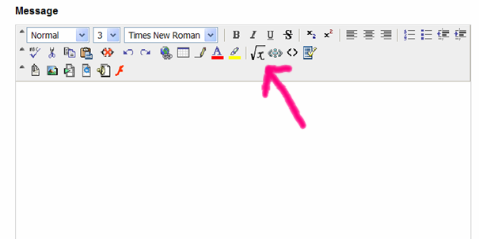
Inside the Discussion Board reply to a message or start a new thread
The following dialogue box appears
When you are ready to type your equation, hit the Equation Editor icon indicated by the arrow.

Slide 3
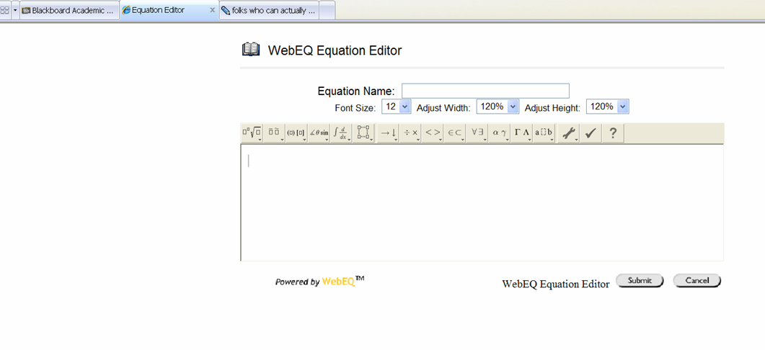
The WebEQ Equation Editor opens in a new window

Slide 4
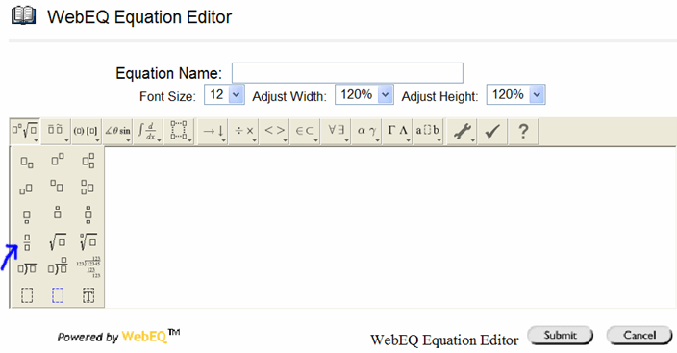
The Equation Editor works by a series of templates.
Let’s try writing a fraction
Click on the first template box and select the fraction template indicated with the blue arrow.

Slide 5
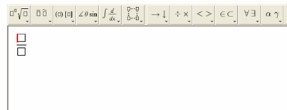
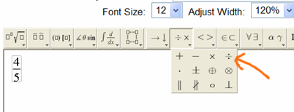
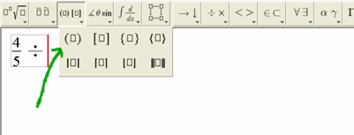
The template appears on the screen, and you fill in the boxes

Slide 6
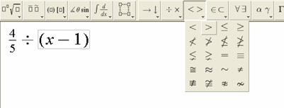
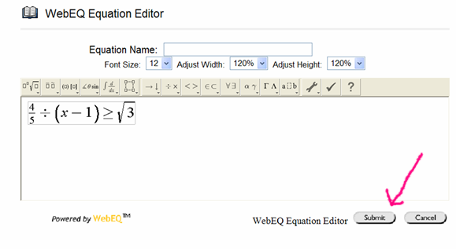
Finish the equation
When you are done, hit submit

Slide 7
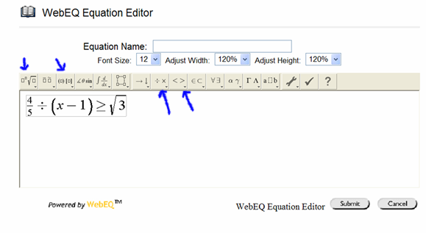
What are these other buttons for?
The only buttons you’ll use in Math 111 are the ones with the blue arrows:
You’ll learn about the other ones if you take higher level math classes.

Slide 8
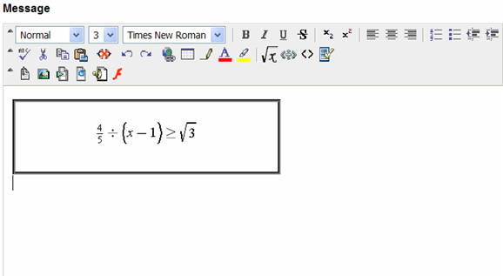
This is how it looks when you’re done
Type your explanation or click on the Equation Editor icon to start another.

