Slide 1
GEO-pardy!
1
2
3
4
5
6
7
8
9
M
10
11
12
$100
$100
$100
$100
$100
$100
$100
$100
$100
$100
$100
$100
$100
$200
$200
$200
$200
$200
$200
$200
$200
$200
$200
$200
$200
$200
$300
$300
$300
$300
$300
$300
$300
$300
$300
$300
$300
$300
$300
$400
$400
$400
$400
$400
$400
$400
$400
$400
$400
$400
$400
$400
$500
$500
$500
$500
$500
$500
$500
$500
$500
$500
$500
$500
$500

Slide 2
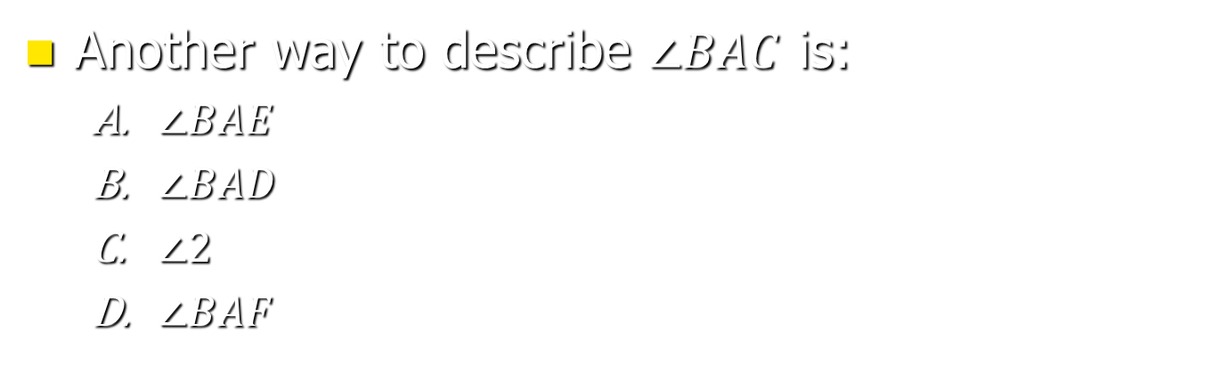
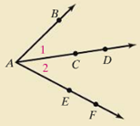
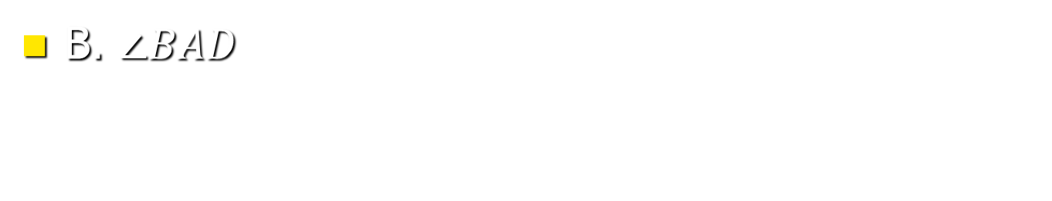
1 - $100

Slide 3
1 - $200
The smallest number of noncollinear points needed to describe a plane is _____________.
three

Slide 4
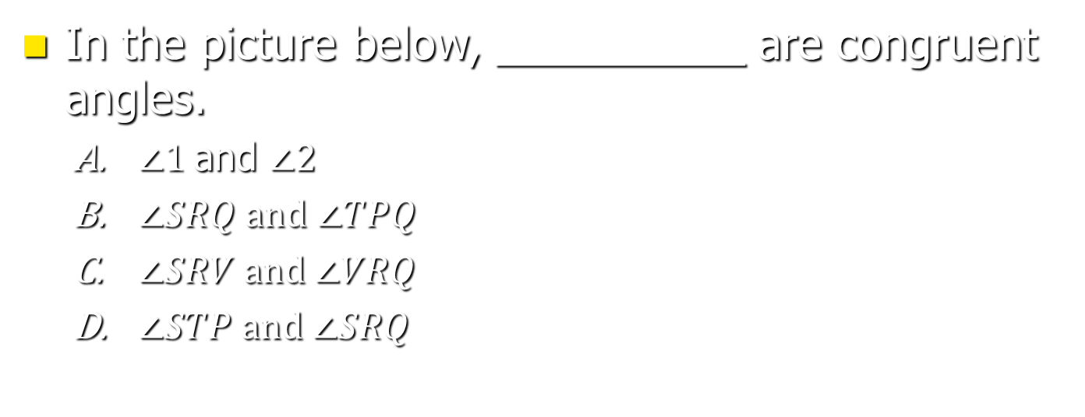
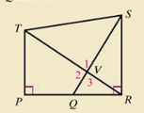
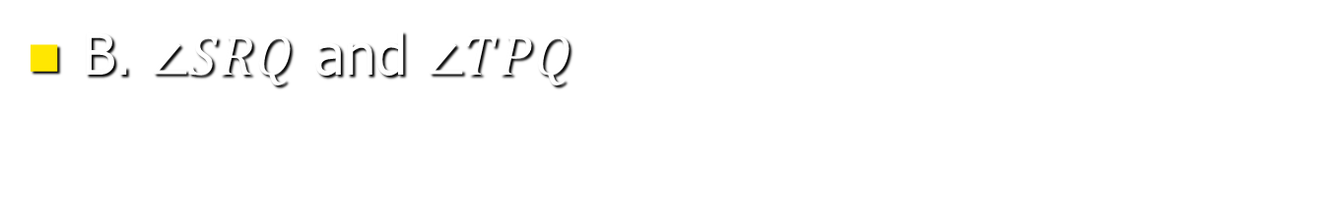
1 - $300

Slide 5
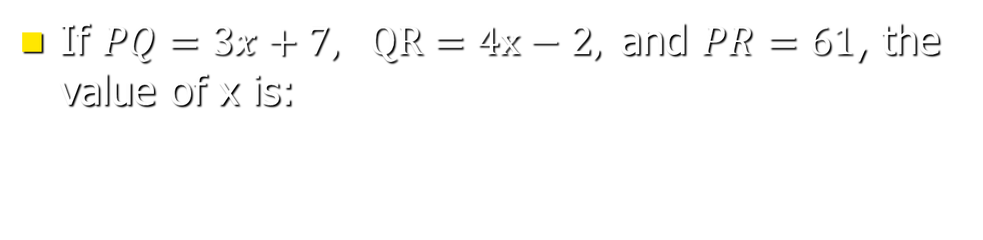
1 - $400
P Q R
8

Slide 6
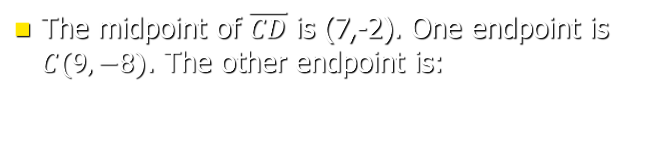
1 - $500
D(5,4)

Slide 7
2 - $100
Identify the hypothesis and the conclusion of the statement “Dogs are retrievers.”
  Hypothesis: An animal is a dog.
  Conclusion: An animal is a retriever.
  Hypothesis: An animal is a retriever.
  Conclusion: An animal is a dog.
  C. None of these
A.

Slide 8
2 - $200
The area of a rectangle that measures 5 yards in length and 2 feet in width is:
30 square feet

Slide 9
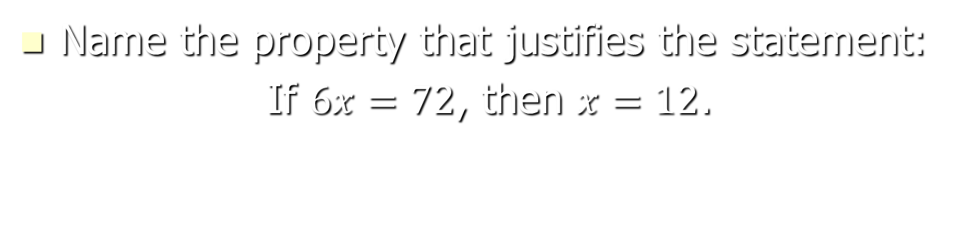
2 - $300
Division Property of Equality

Slide 10
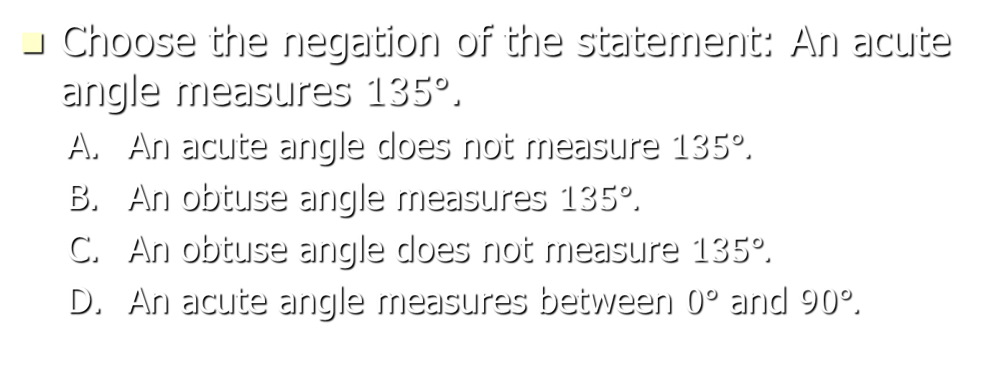
2 - $400
A.

Slide 11
2 - $500
For the statement “Pine trees have needles,” write the contrapositive as an if-then statement.
If a tree does not have needles, then it is not a pine tree.

Slide 12
3 - $100
Noncoplanar lines that do not intersect are called…
Skew lines

Slide 13
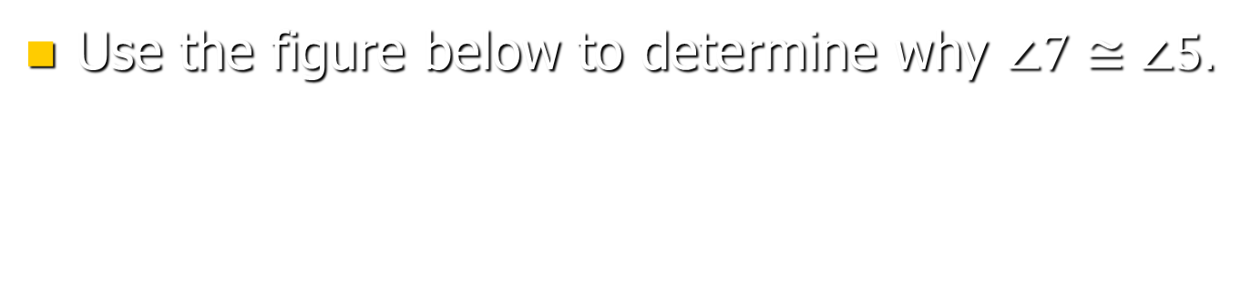
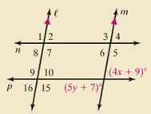
3 - $200
They are corresponding angles.

Slide 14
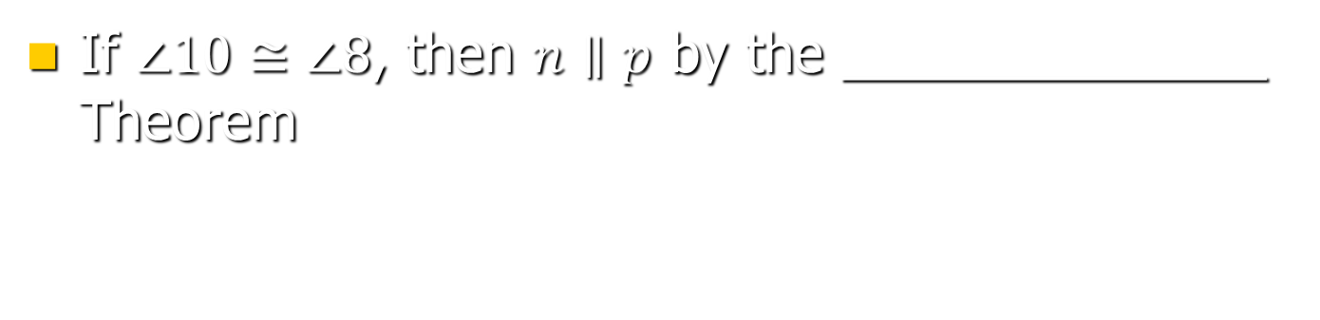
3 - $300
Alternate Interior Angles

Slide 15
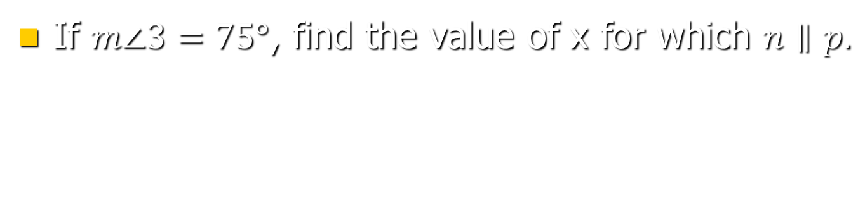
3 - $400
24

Slide 16
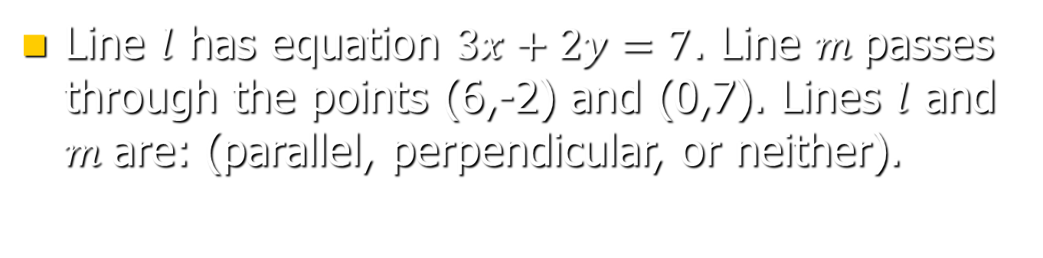
3 - $500
Parallel

Slide 17
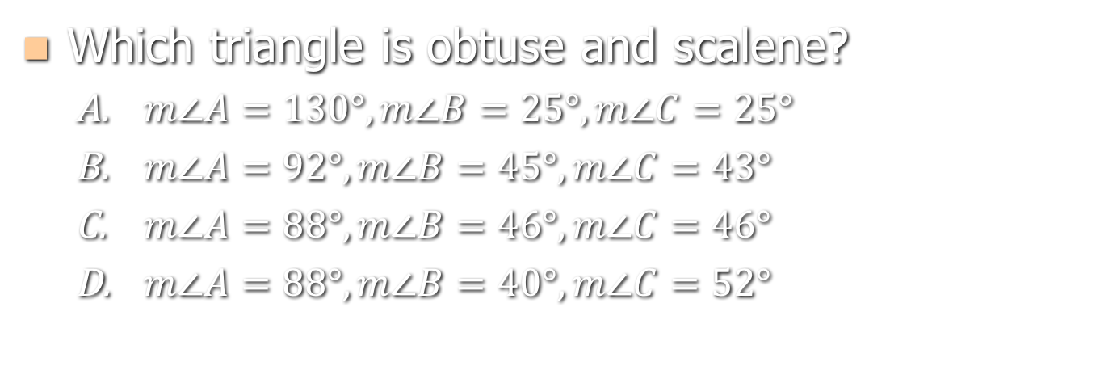
4 - $100
B.

Slide 18

4 - $200
What is the measure of angle 2 below?
58 degrees

Slide 19

4 - $300
What is the measure of angle 2?
107 degrees

Slide 20
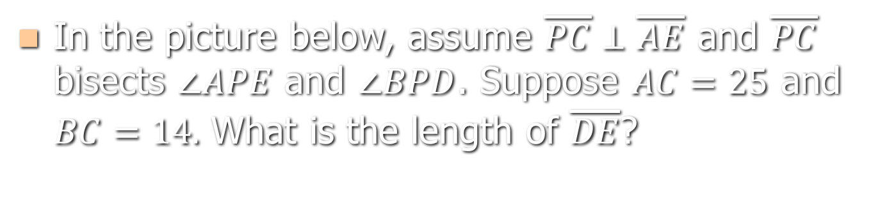

4 - $400
11 units

Slide 21
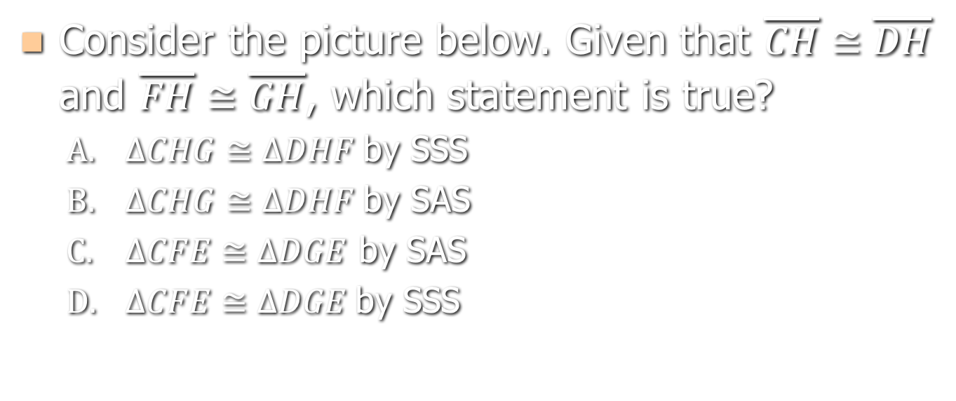
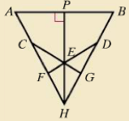
4 - $500
B.

Slide 22
5 - $100
What is the name of the point of concurrency of angle bisectors?
Incenter

Slide 23
5 - $200
What is the name of the point where a triangle of uniform thickness would balance?
Centroid

Slide 24
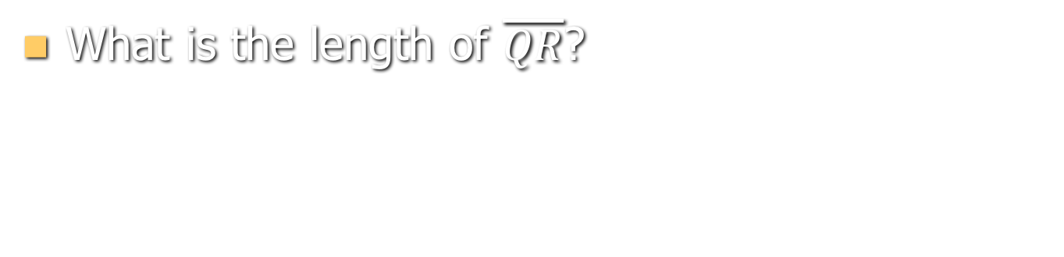
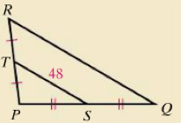
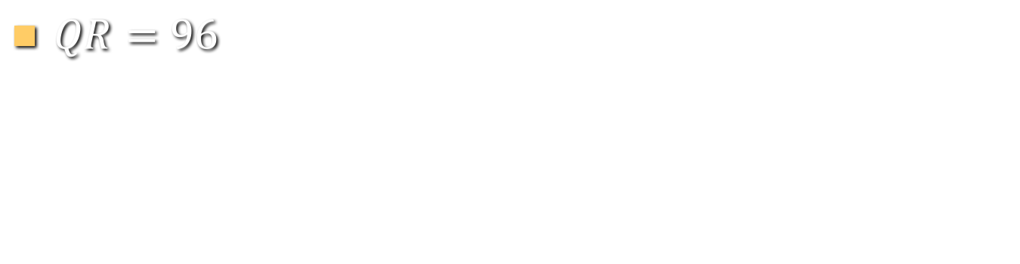
5 - $300

Slide 25
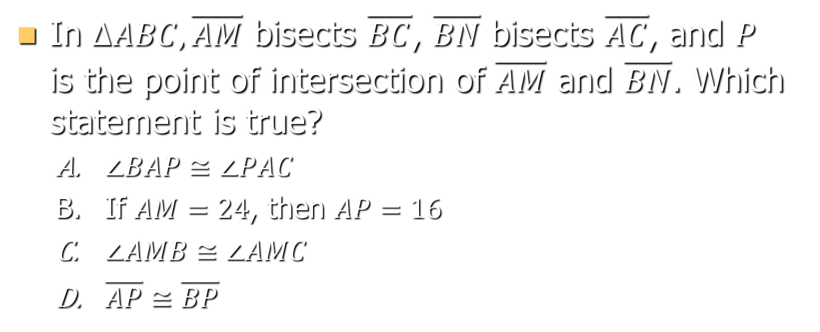
5 - $400
In $ΔABC, \overline{AM}$ bisects $\overline{BC}$, $\overline{BN}$ bisects $\overline{AC}$, and $P$ is the point of intersection of $\overline{AM}$ and $\overline{BN}$. Which statement is true?
  $∠BAP≅∠PAC$
  If $AM=24$, then $AP=16$
  $∠AMB≅∠AMC$
  $\overline{AP}≅\overline{BP}$
B.

Slide 26
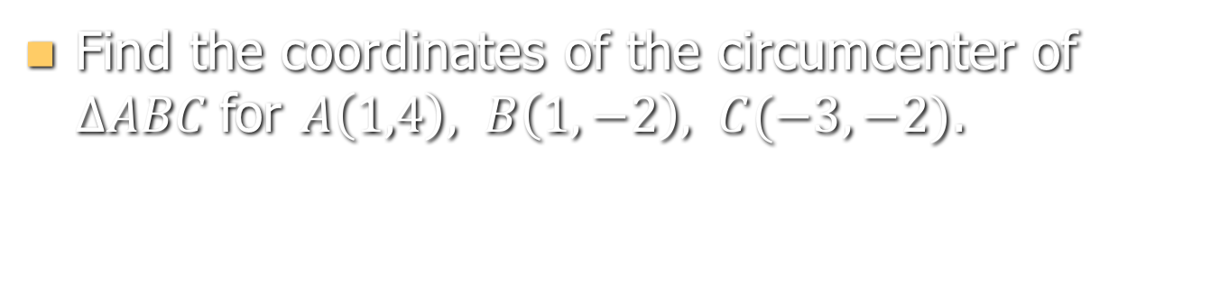
5 - $500
(-1, 1)

Slide 27
6 - $100
True or False: All equilateral polygons are regular.
False

Slide 28
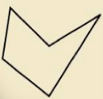
6 - $200
Classify the polygon below by number of sides and concavity/convexity.
Concave pentagon

Slide 29
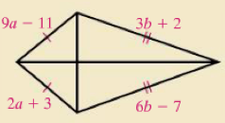
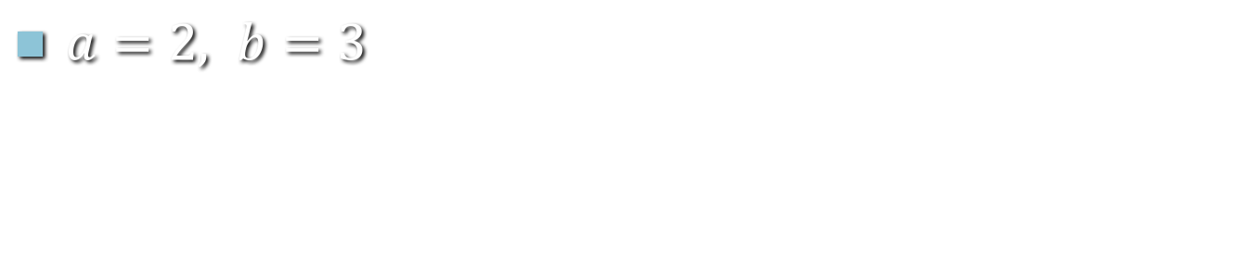
6 - $300
Find the value of a and b in the polygon below.

Slide 30
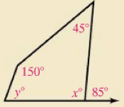
6 - $400
Find the value of y.
70 degrees

Slide 31
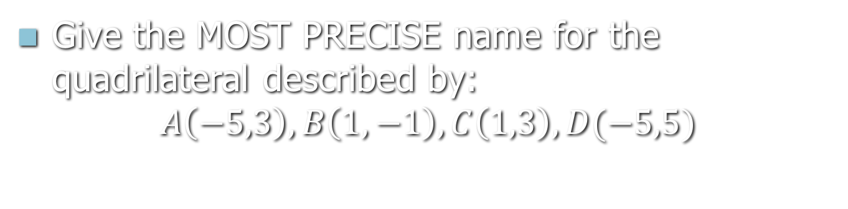
6 - $500
Isosceles trapezoid

Slide 32
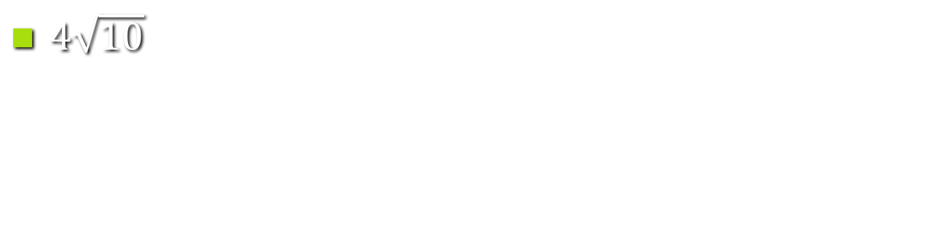
7 - $100
What is the geometric mean of 8 and 20?

Slide 33
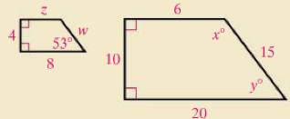
7 - $200
If the two figures below are similar, find x.
127 degrees

Slide 34
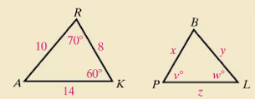
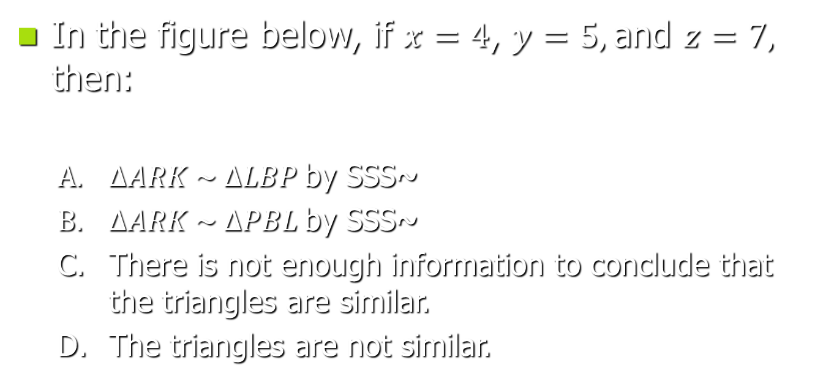
7 - $300
In the figure below, if $x=4$, $y=5,$and $z=7,$ then:
  $ΔARK \sim ΔLBP$by SSS~
  $ΔARK \sim ΔPBL$by SSS~
  There is not enough information to conclude that the triangles are similar.
  The triangles are not similar.
A.

Slide 35
7 - $400
If the two figures below are similar, find z.
2.4 units

Slide 36
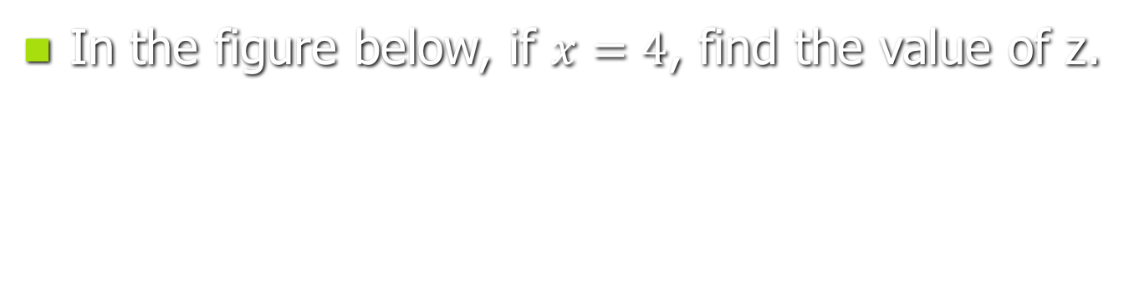
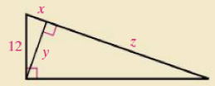
7 - $500
32

Slide 37
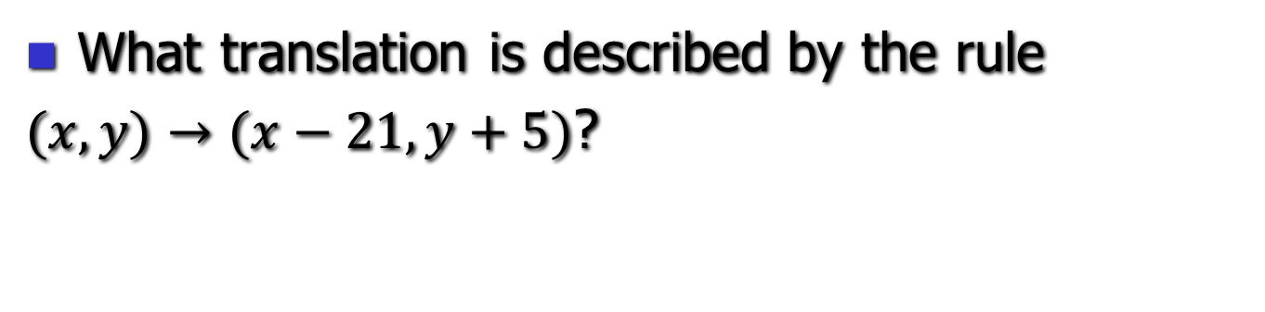
8 - $100
21 units right, 5 units up

Slide 38
8 - $200
Fill in the blank with always, sometimes, or never.
A dilation is _______________ an isometry
Sometimes

Slide 39
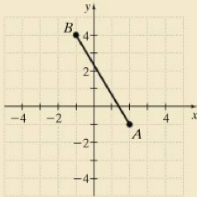
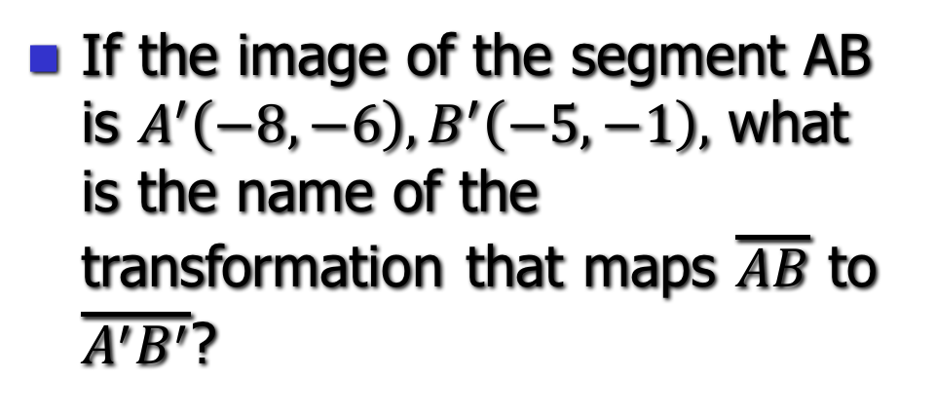
8 - $300
If the image of the segment AB is $A^{′}\left(−8,−6\right), B^{′}\left(−5,−1\right),$ what is the name of the transformation that maps $\overline{AB}$ to $\overline{A^{′}B^{′}}$?
Glide reflection

Slide 40
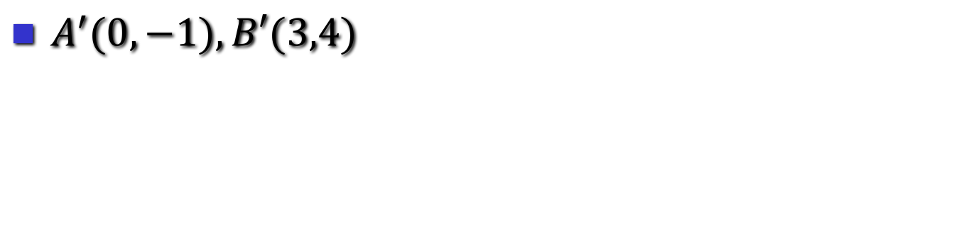
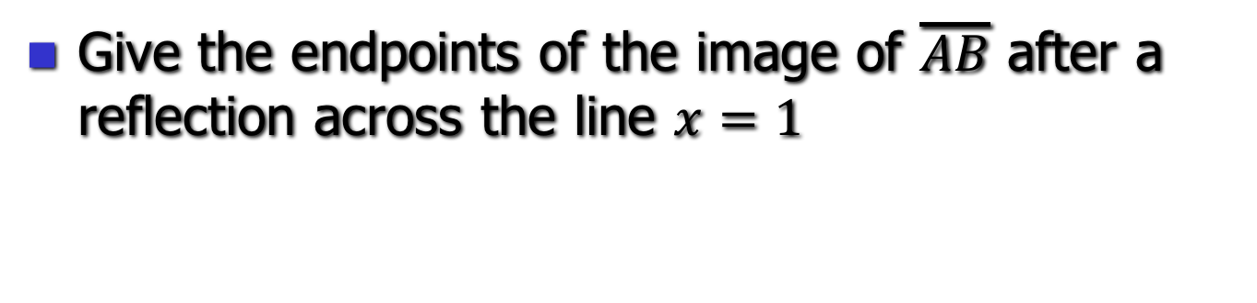
8 - $400
Give the endpoints of the image of $\overline{AB}$ after a reflection across the line $x=1$
$A^{′}(0,−1),B′(3,4)$

Slide 41

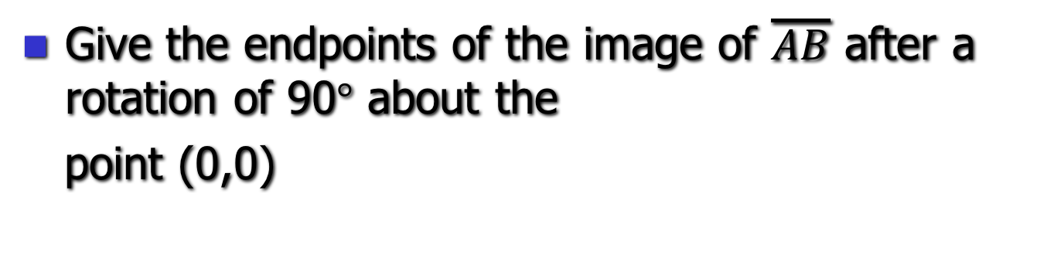
8 - $500
Give the endpoints of the image of $\overline{AB}$ after a rotation of 90$°$ about the
point (0,0)
$A^{′}\left(1,2\right), B′(−4, −1)$

Slide 42
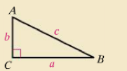
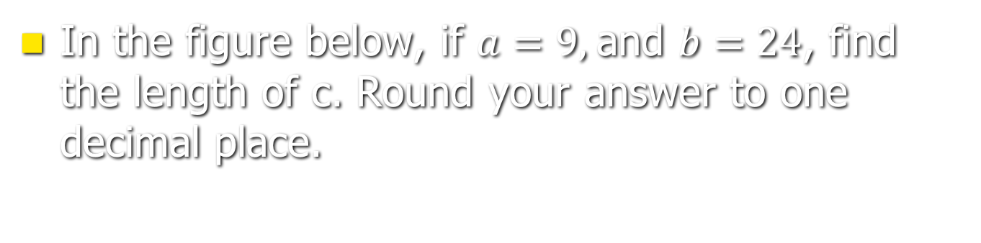
9 - $100
In the figure below, if $a=9,$and $b=24$, find the length of c. Round your answer to one decimal place.
25.6

Slide 43
9 - $200
Which set of numbers is a Pythagorean triple?
  4.5, 6, 7
  3, 4, 6
  16, 30, 34
  None of the above
C.

Slide 44
9 - $300
Is a triangle with side lengths 14 cm, 18 cm, and 22 cm acute, right, or obtuse?
acute

Slide 45
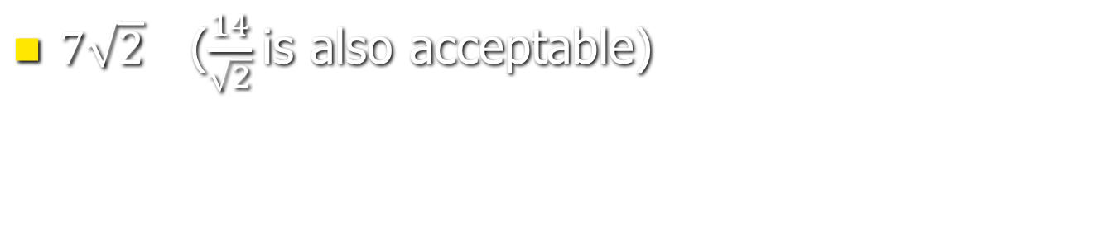
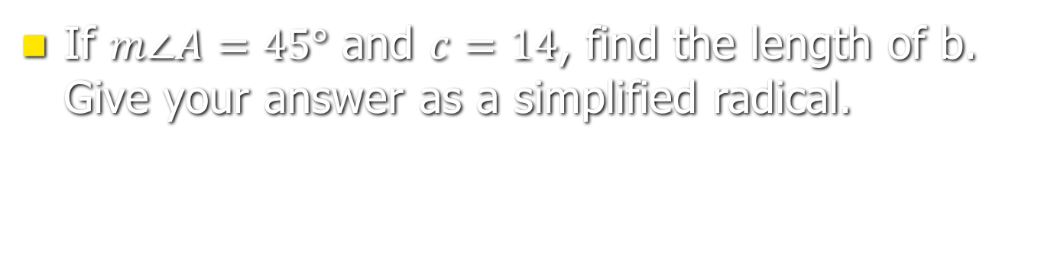
9 - $400
If $m∠A=45°$ and $c=14$, find the length of b. Give your answer as a simplified radical.
$7\sqrt{2}$ ($\frac{14}{\sqrt{2}}$is also acceptable)

Slide 46
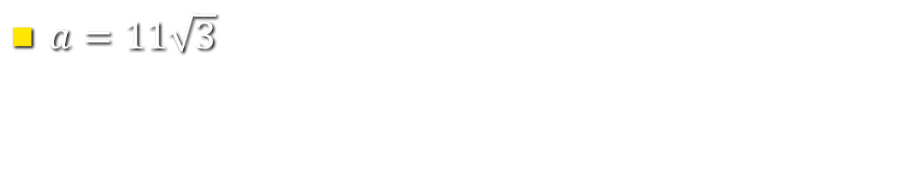
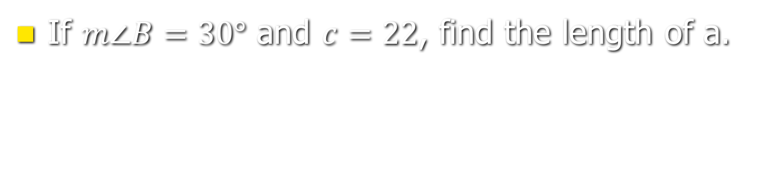
9 - $500
If $m∠B=30°$ and $c=22$, find the length of a.
$a=11\sqrt{3}$

Slide 47
Measurement - $100
What is the most reasonable unit of measurement: The recommended daily dose of vitamin C is:
250 g, 60 mg, 0.3 kg, 0.002 mg
60 mg

Slide 48
Measurement - $200
Autumn Courtney, a baby, is 83.84 centimeters long. Which of the following is equivalent to 83.84 centimeters?
  0.08384 m
  834.8 m
  0.8384 m
  8.834 m
C.

Slide 49
Measurement - $300
The dimensions of Noah’s Ark are given in the Bible as 300 cubits long, 50 cubits wide, and 30 cubits high. If Noah’s forearm, elbow to fingertips, measured approximately 1.5 feet, give the length of his ark in yards.
150 yards

Slide 50
Measurement - $400
A quart and a liter of the same brand of sparkling water are on a shelf. If they are the same price, which one should you pick?
  (Use the fact that a gallon is approximately 3.8 liters)
The liter

Slide 51
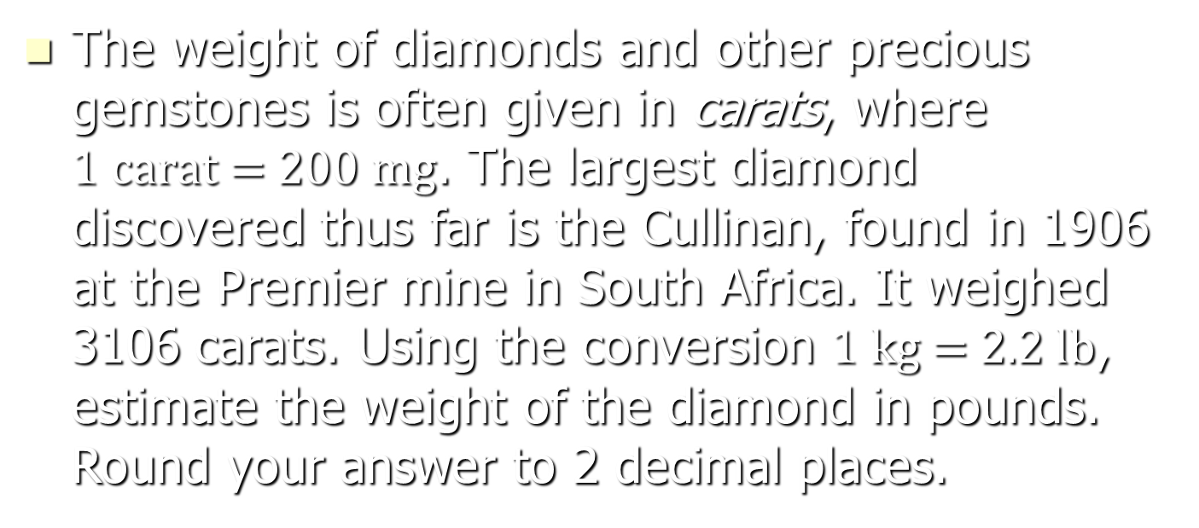
Measurement - $500
The weight of diamonds and other precious gemstones is often given in carats, where $1 \text{carat}\text{ = 200 }\text{mg}$. The largest diamond discovered thus far is the Cullinan, found in 1906 at the Premier mine in South Africa. It weighed 3106 carats. Using the conversion $1 \text{kg}\text{ = 2.2 }\text{lb}$, estimate the weight of the diamond in pounds. Round your answer to 2 decimal places.
Approximately 1.37 pounds

Slide 52
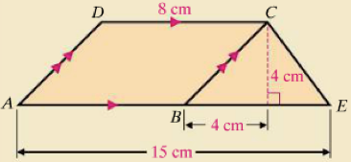
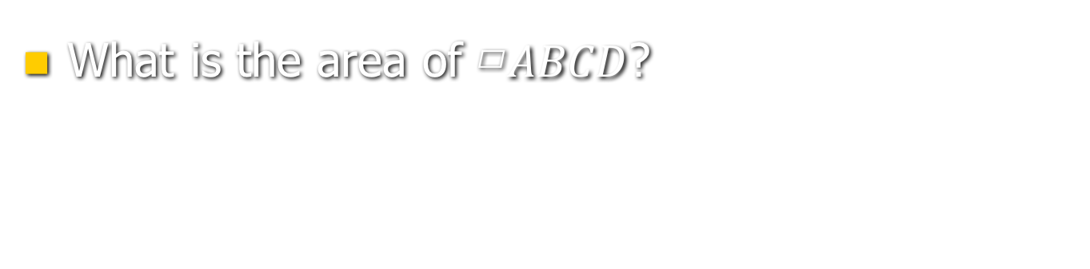
10 - $100
What is the area of ▱$ABCD$?
32 sq cm

Slide 53


10 - $200
What is $m\overset{⏜}{BC}$? (That is, the angular measure, not the length.)
55 degrees

Slide 54

10 - $300
2.5 sq ft

Slide 55


10 - $400
In the figure below, if $x=24$, find $m∠1$.
75.5 degrees

Slide 56

10 - $500
A regular hexagon has radius 12 mm long. What is the area of the hexagon?

Slide 57
11 - $100
Which figure is not a possible cross section when a cylinder is intersected by a plane?
  Circle
  Square
  Rectangle
  None of these
D.

Slide 58
11 - $200
Which of the following options are possible for a polyhedron?
  7 faces, 9 vertices, 14 edges
  10 faces, 12 vertices, 20 edges
II only

Slide 59
11 - $300
What is the surface area of a cone with radius 6 in. and slant height 10 in.? (Round to the nearest whole number)
302 sq in.

Slide 60


11 - $400
Identify the figure corresponding to the net.
  Square pyramid with base edges 10 cm and height 13 cm
  Square pyramid with base edges 10 cm and height $\sqrt{69}$ cm
  Square pyramid with base edges 10 cm and height 12 cm
  None of these
C.

Slide 61
11 - $500
A storage tank is in the shape of a cylinder topped by a hemisphere. The radius of the tank is 10 ft and the height of the cylinder part of the tank is 30 ft. The top and lateral surface are to be painted with two coats of paint. If one gallon of paint covers 350 sq ft, how many gallons of paint must be purchased?
15 gallons

Slide 62

12 - $100
What is the standard equation of the circle with center (8, -2) and radius 3?

Slide 63


12 - $200
Identify the graph of
$${\left(x+1\right)}^{2}+{\left(y−1\right)}^{2}=4$$
D.

Slide 64

12 - $300
Find the value of x in the figure below.
13

Slide 65

12 - $400
Find the value of x in the figure below.
36

Slide 66

12 - $500
Find the value of x.
30 degrees

